Slide 1
Some Ottoman (Turkish) Medals of the First World War

Slide 2
The Turkish War Medal of 1915
This medal is sometimes called the Gallipoli star

Slide 3
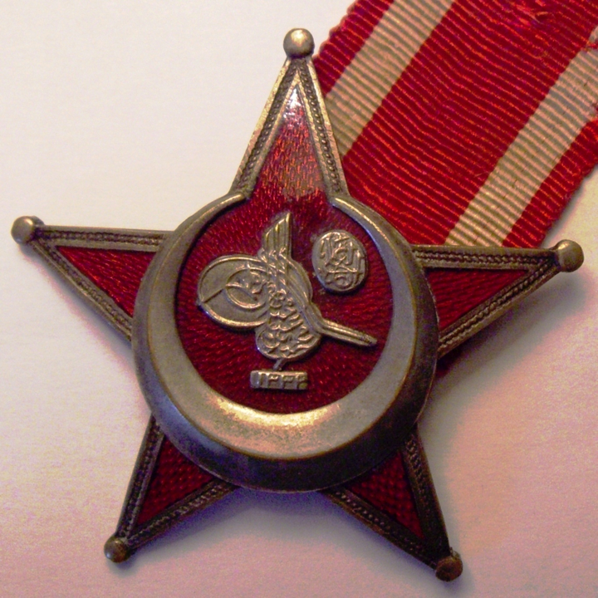

Slide 4
The Imtiaz Medal of 1915
This gold medal is for the most excellent military service in The Ottoman Turkish army
There was a second class version made of silver

Slide 5
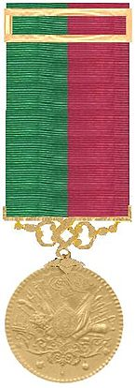
The Imtiaz medal

Slide 6
The Iron Cross
A German military medal given for bravery
It was sometimes awarded to Turks fighting with the Germans in the first world war

Slide 7
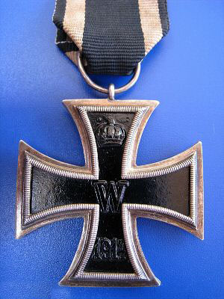
The Iron Cross

Slide 8
The Liyakat Medal
This gold medal was the junior ranking type of medal in the Ottoman Turkish awards
There was a second class version made of silver
and a third class one made of bronze
The crossed swords on the ribbon tell us it was won in battle

Slide 9
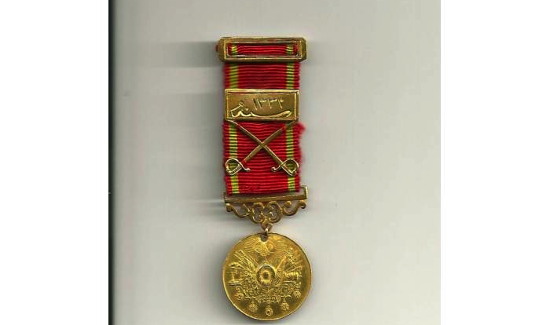
Likayat Medal (gold)

Slide 10
The Order of Medjid
A highly regarded Order, given to those serving in the Ottoman Turkish forces, as well as to those such as the Germans, fighting with them

Slide 11
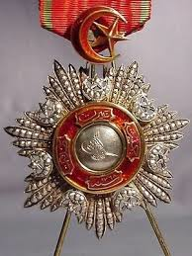
The Order of Medjid

Slide 12
The Order of Osmanie: the Order of the Ottoman Empire
This was awarded by the Sultan for most excellent conduct
The Order shown may have belonged to King Edward VII of England
(Royal Collection Trust/© Her Majesty Queen Elizabeth II 2014)

Slide 13
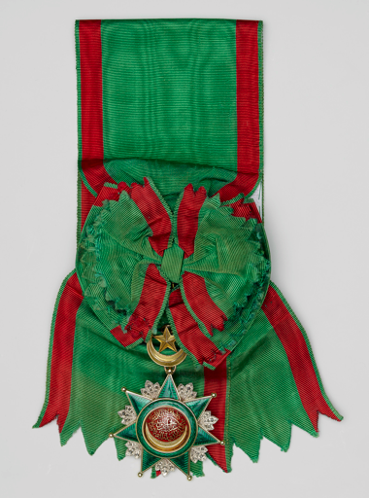
The Osmanie Order

Slide 14
For comparison: the Distinguished Service Cross
This medal is awarded to officers in the British forces for bravery
F.S.’Cleg’ Kelly, the composer, won this medal for hi part in the British withdrawal from Gallipoli

Slide 15
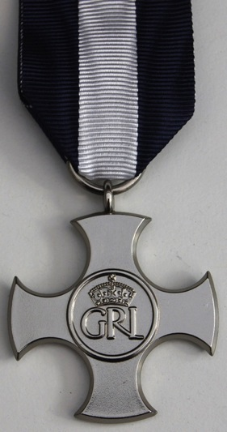
Distinguished Service Cross

Slide 16
For comparison: the Légion d’honneur
This award is given to those in the French armed forces for exceptional conduct in battle
Jean Giraudoux, the playwright and diplomat, won this award for his courage in fighting units of the Turkish division commanded by Selahattin Adil on 21st June 1915

Slide 17
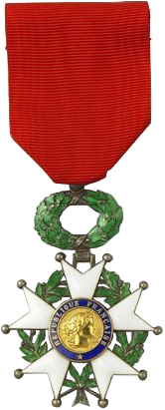
Légion d’honneur

Slide 18
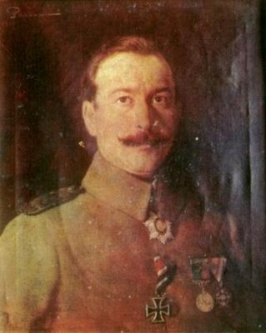
Which medals and awards is Selahattin Idal Pasha wearing?

