Slide 1
Plenary
What do we know about mining in Durham before the First World War?

Slide 2
True or False?
You could leave school and start work at the age of 12 in the 1900s
In many places the mining companies owned the places people lived in and took money for rent off their pay
The tunnels in the mines were always two metres high
If you were good at greasing the machinery in Burnopfield Colliery, you could be promoted to driving the pit ponies
Boys were only allowed to work for eight hours a day

Slide 3
True or False?
You could leave school and start work at the age of 12 in the 1900s
In many places the mining companies owned the places people lived in and took money for rent off their pay
The tunnels in the mines were always two metres high
If you were good at greasing the machinery in Burnopfield Colliery, you could be promoted to driving the pit ponies
Boys were only allowed to work for eight hours a day
✓
✓
✗
✓
✗

Slide 4
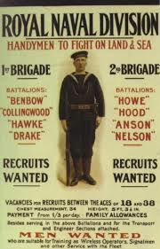
Joe Murray worked in the mines for six years.
And then?

Slide 5
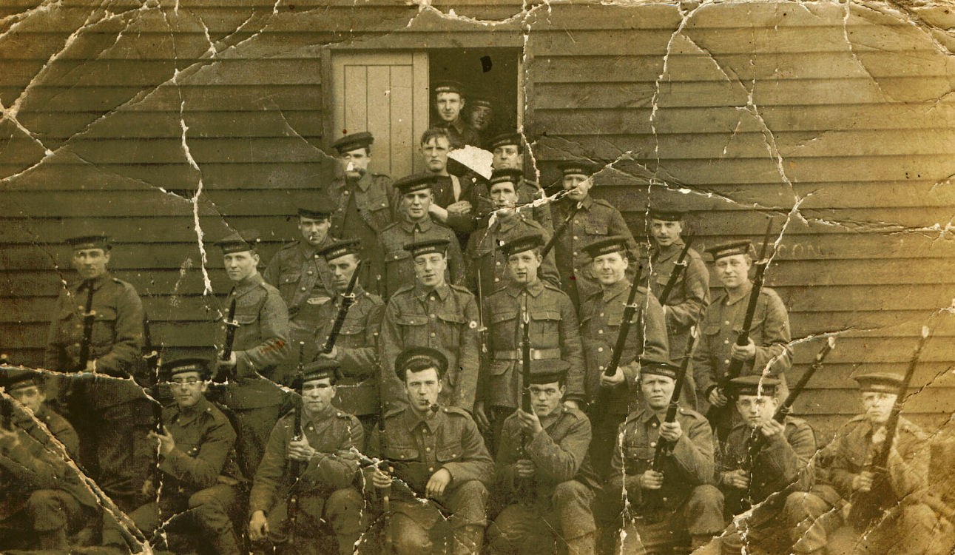
Some of the Royal Naval Division at Blandford Camp

