Slide 1
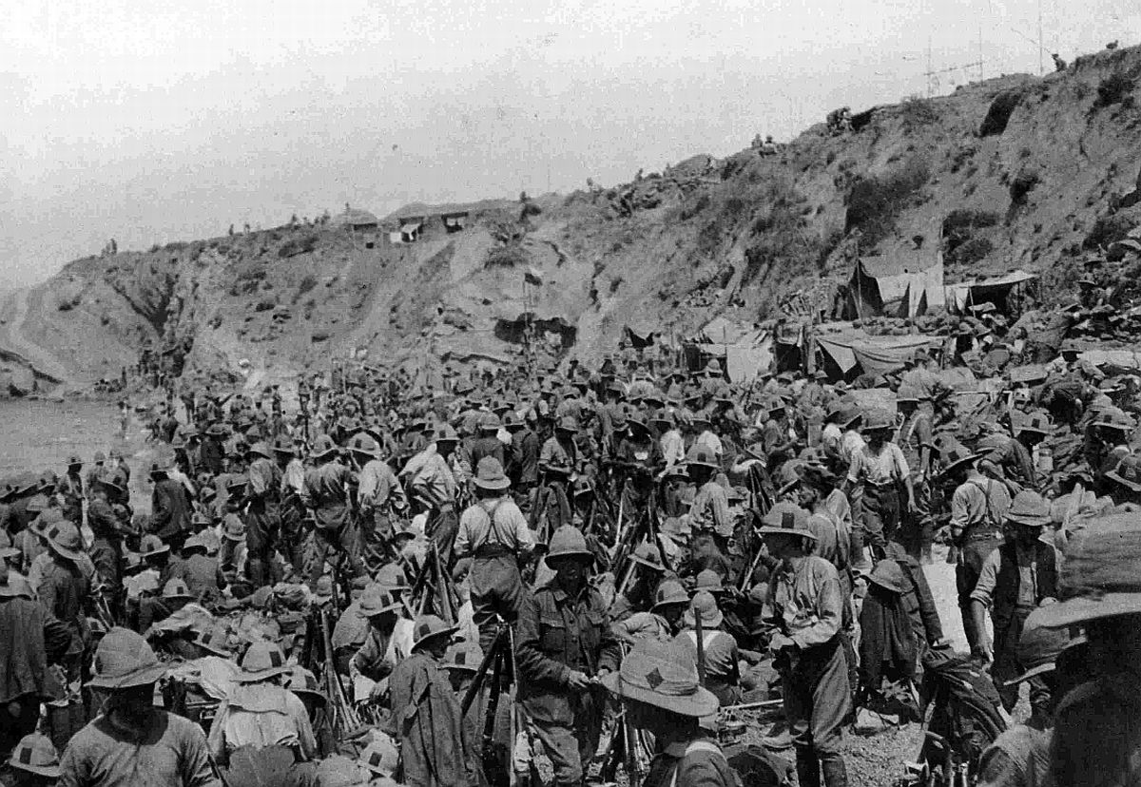
What were the key features of the Gallipoli Campaign: April 1915 – January 1916?

Slide 2
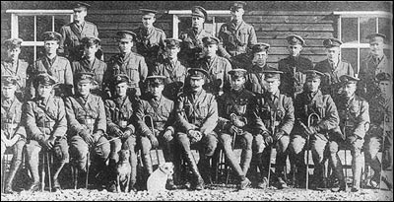
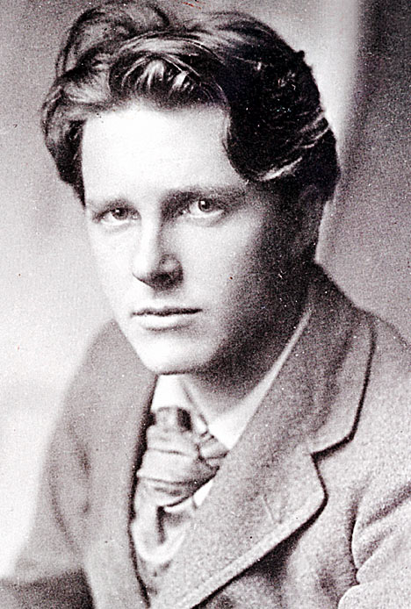
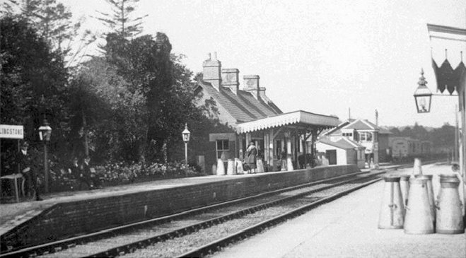
Starter: Here are the answers, but what are the questions?
They arrived in Blandford in November 1914.
Marching, digging trenches and drill.
The ‘most handsome man in England’.
Shillingstone Station
A mosquito bite.

Slide 3
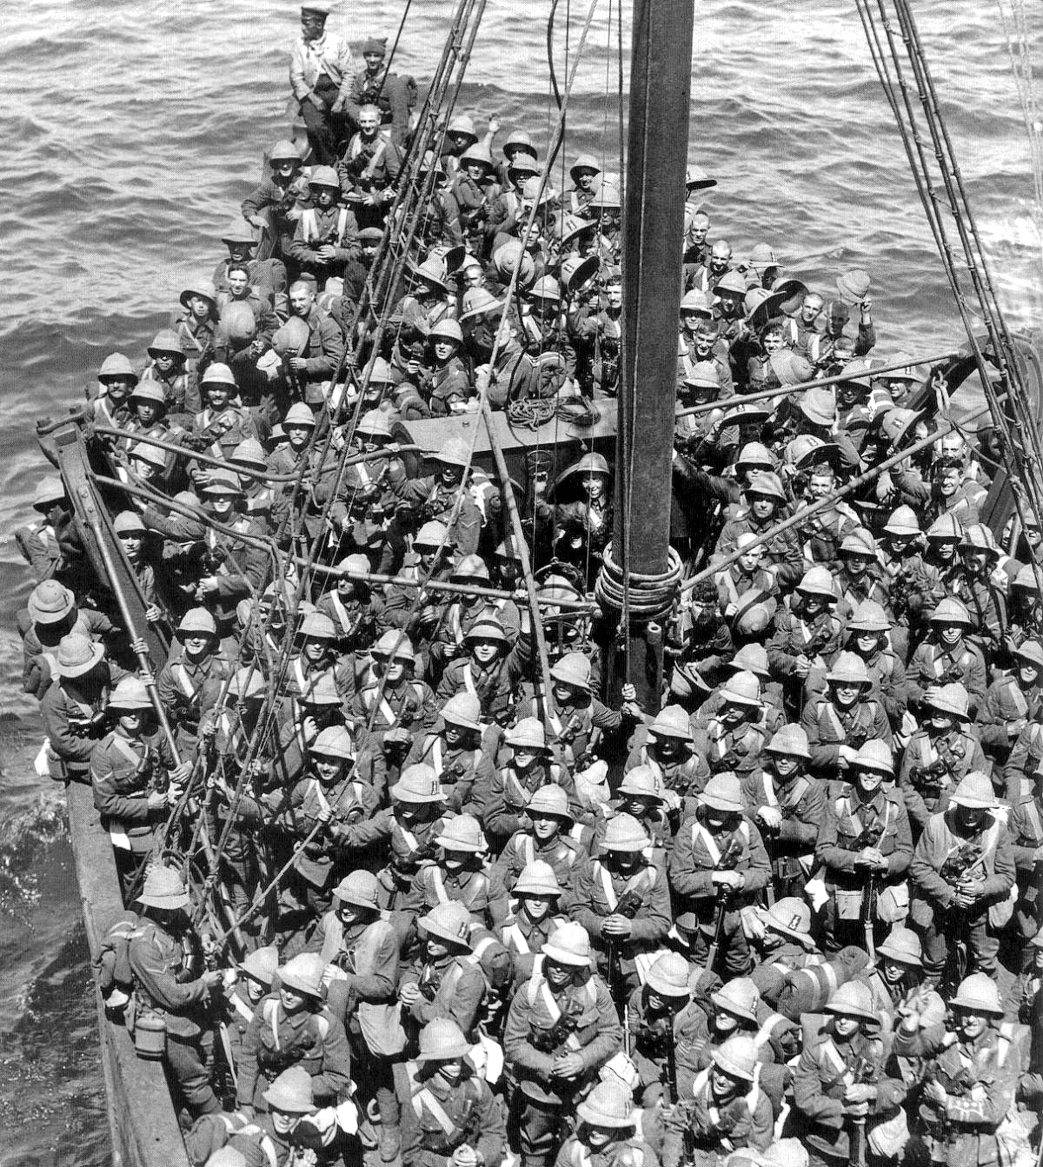
Learning outcomes
All to identify the key features of the Gallipoli Campaign
Most to be able to explain these features
Some to be able to draw conclusions about the reasons for the campaign’s failure

Slide 4
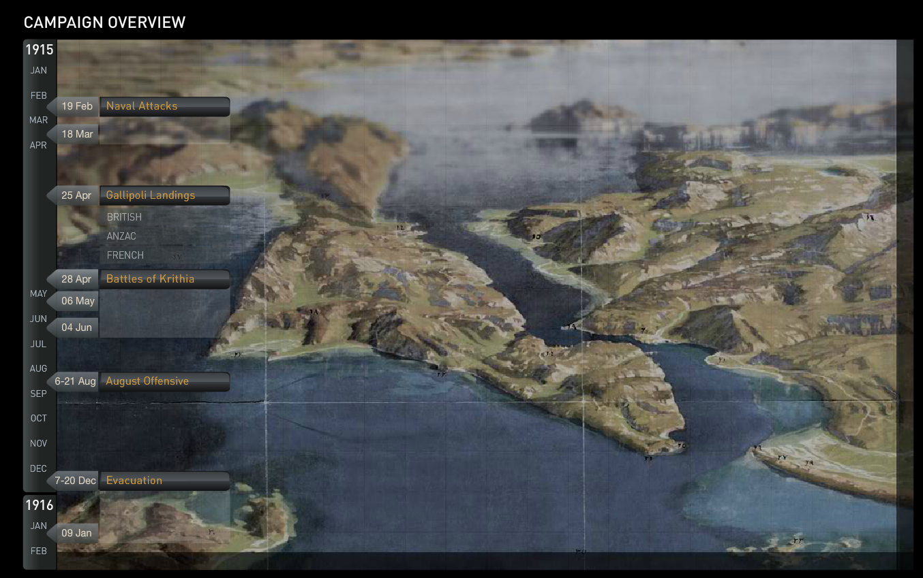

Slide 5
Task 1: To identify the key features of the Gallipoli Campaign
In your group to work upon one of the following themes
The landings
The battles for Krithia
The RND and the Third Battle of Krithia
The August Offensive
Conditions on the battlefield
The evacuation

Slide 6
Task 2: To identify the key features of the Gallipoli Campaign
Start by reading your section carefully
Highlight five key features you believe are the essential issues
Discuss this in your group
Decide now what the group believes to be the five key features
Record these onto your sheet
Be prepared to present these to the rest f the class and to explain each feature

Slide 7
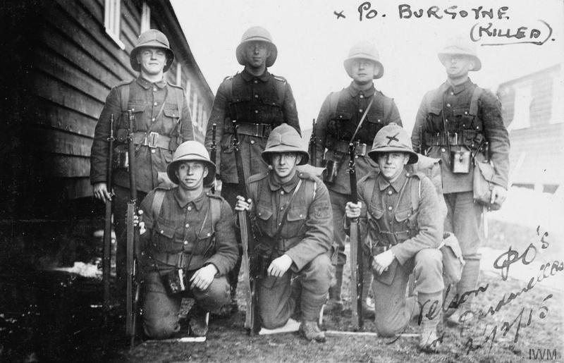
Task 2
You should complete your leaflet begun last lesson on the role of the Royal Naval Division at Gallipoli

Slide 8
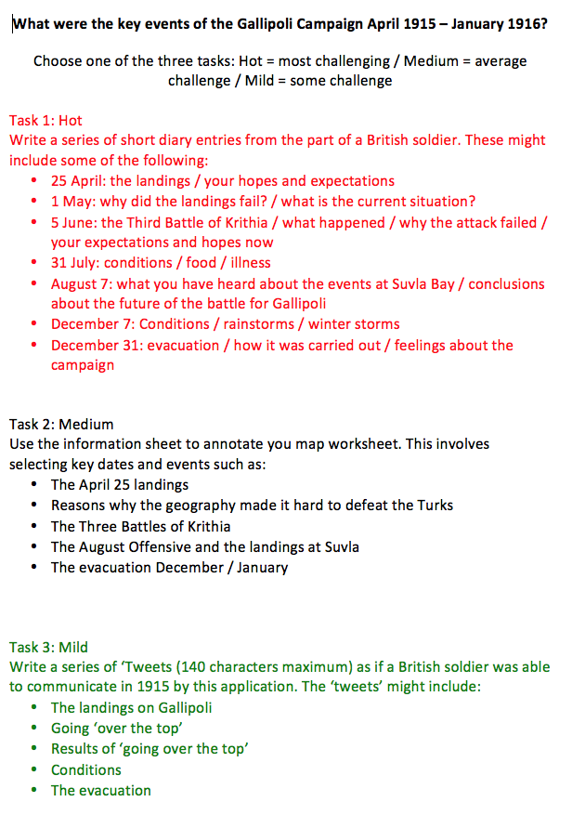
Homework
Select one of the three homework tasks
They each have a different level of challenge

