Slide 1
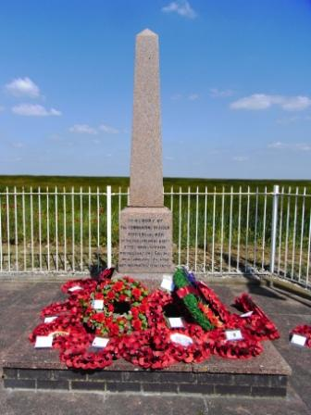
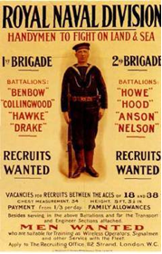
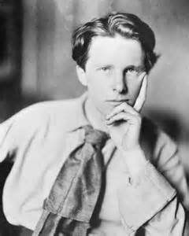
What is the connection between Blandford, the Royal Naval Division and Gallipoli?

Slide 2
The RND, Blandford and Gallipoli: Key Questions

Slide 3
Learning outcomes
To research the connection between Blandford and the Gallipoli Campaign
To select and deploy a range of relevant sources
To explain the nature of the Royal Naval Division before and how it prepared for the Gallipoli Campaign

Slide 4
Starter: True or False?
The war on the Western Front had reached a stalemate by 1915.
The idea of attacking Turkey came from Winston Churchill.
The attack on the Dardanelles would help to force Austria out of the war.
It would also help to get supplies to Britain’s ally, Russia.
Troops would be sent from Italy to support the attack.
Some of the troops came from the Royal Naval Division.

Slide 5
Starter: True or False?
The war on the Western Front had reached a stalemate by 1915.
The idea of attacking Turkey came from Winston Churchill.
The attack on the Dardanelles would help to force Austria out of the war.
It would also help to get supplies to Britain’s ally, Russia.
Troops would be sent from Italy to support the attack.
Some of the troops came from the Royal Naval Division.
✓
✓
✗
✓
✗
✓

Slide 6
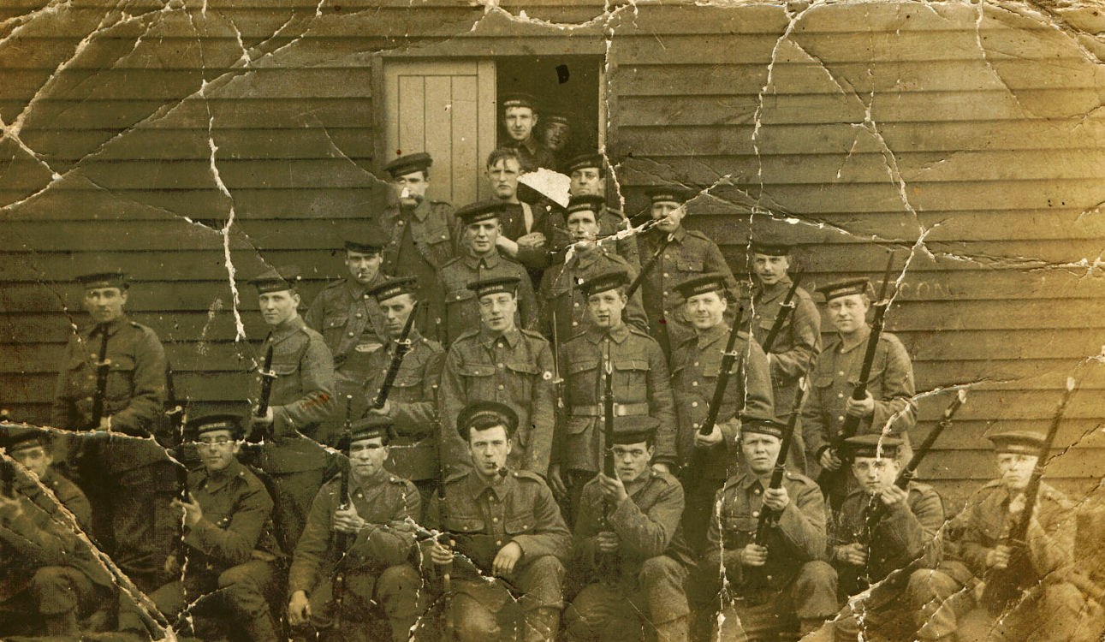
Task: To create a leaflet to be used in the town museum explaining the connection between the Royal Naval Division, Blandford and Gallipoli
To decide upon a series of key questions which will structure the leaflet
To begin researching the issues
To edit the key questions if necessary
To begin producing the leaflet using a range of sources

Slide 7
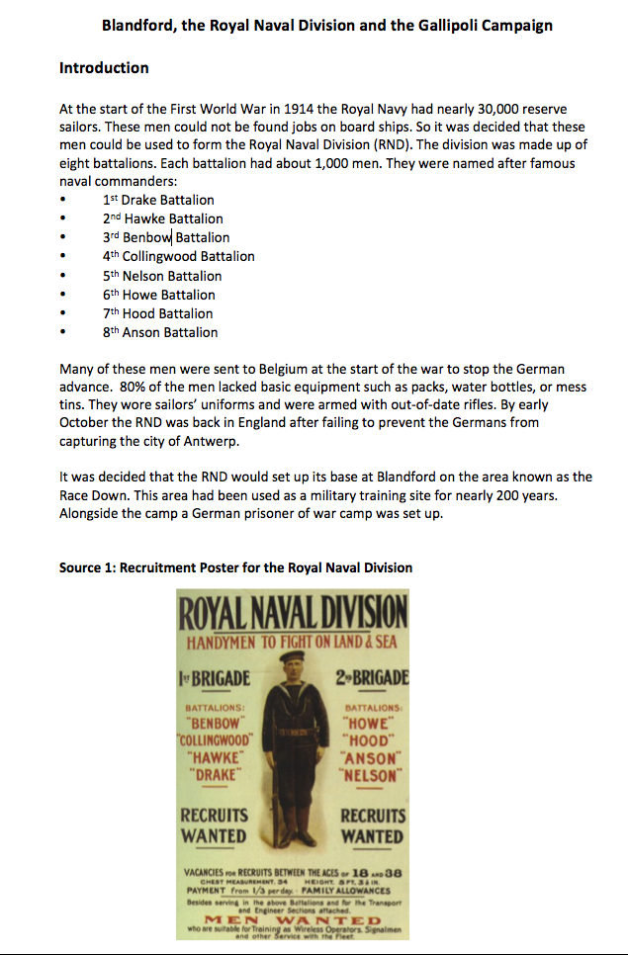
Now try to answer your key questions.
Today you will just be looking at the RND from its creation in 1915 to its departure for Gallipoli in 1915.
Use the sources given to you and any other information you can find

Slide 8
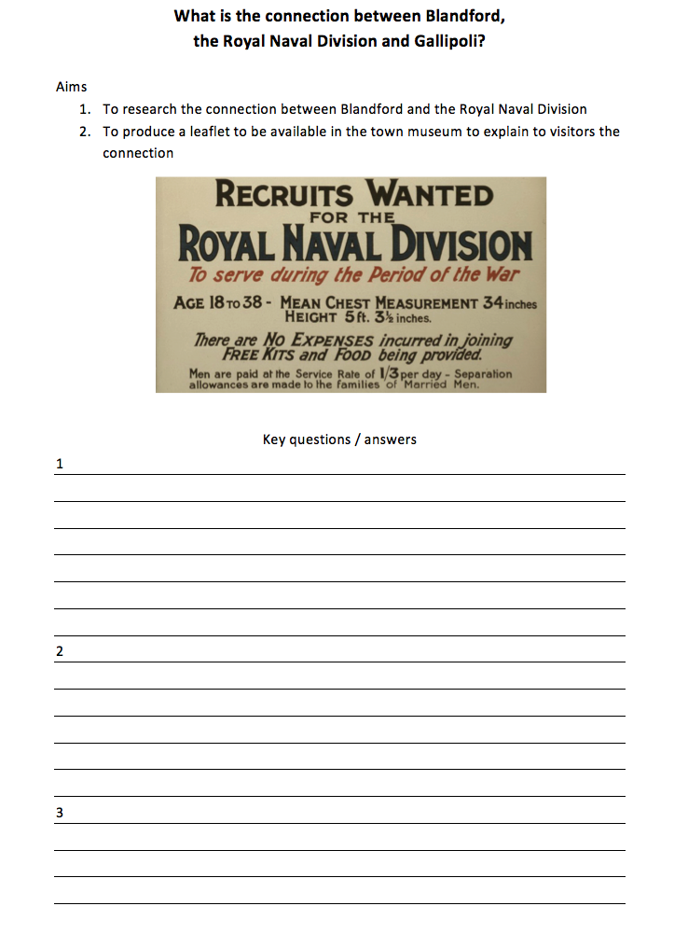
Use the research sheet to record your evidence

Slide 9
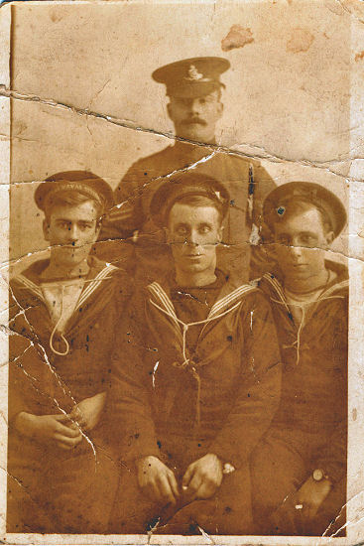
Leaflet: issues to consider
Size?
Shape?
Use of sub-headings?
Images?
Sources?
Websites for further information?
Other ideas?

